Slide 1

GETTING READY to CHANGe THE WORLD
HACKATHON 2021​ ​

Slide 2


"Limiting global warming to 1.5°C would require rapid, far-reaching and unprecedented changes in all aspects of society" - IPCC
"In Sub-Saharan Africa every second person has no access to electricity - a problem that 800M people face globally (2021)" - Worldbank
Notes:
300M in other regions on the globe have the same issue

Slide 3
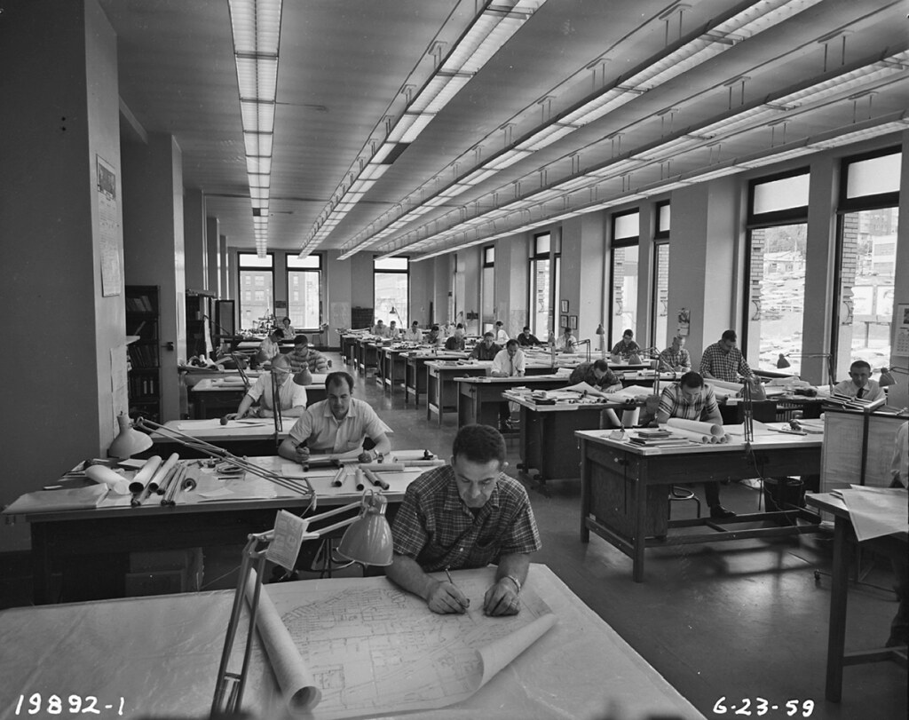
SUSTAINABLE
WE NEED TO PLAN
AFFORDABLE
RELIABLE
"Engineers working on plans, 1959" by Seattle Municipal Archives is licensed under CC BY 2.0

Slide 4

VISION
Create useful alternatives to closed-source energy system model for industry and research
Notes:
How can we achieve that? What are the problems

Slide 5
MISSION
#PyPSA-AFRICA2021
#PyPSA-EARTH2022
#???2023
Notes:
How can we achieve that? What are the problems

Slide 6
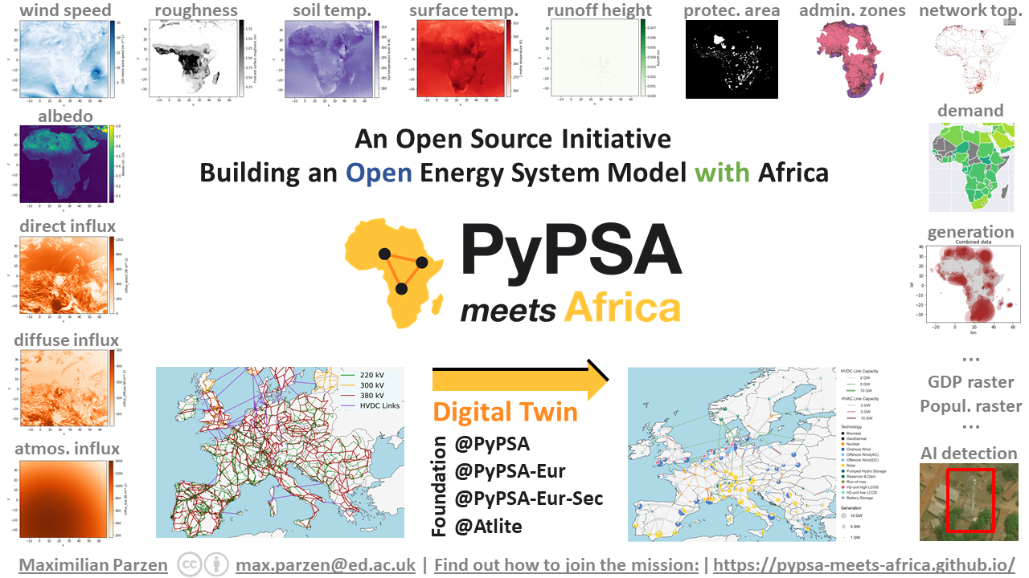
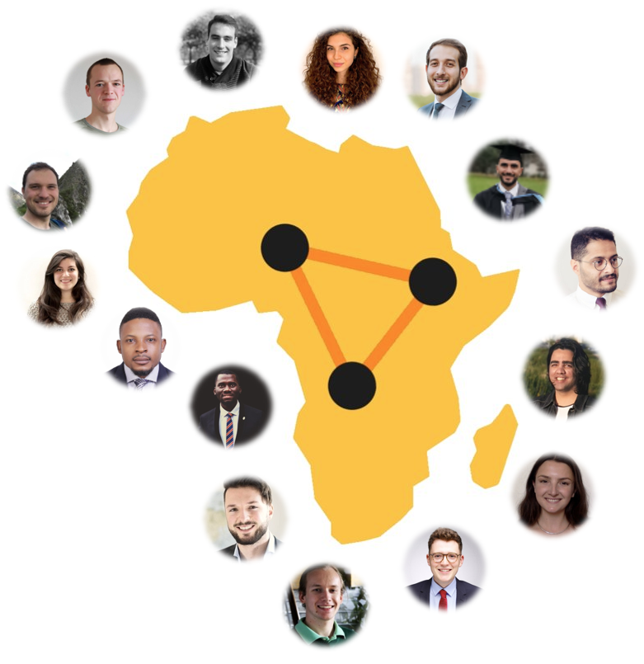
An open digital twin of energy systems
*that can optimize

Slide 7
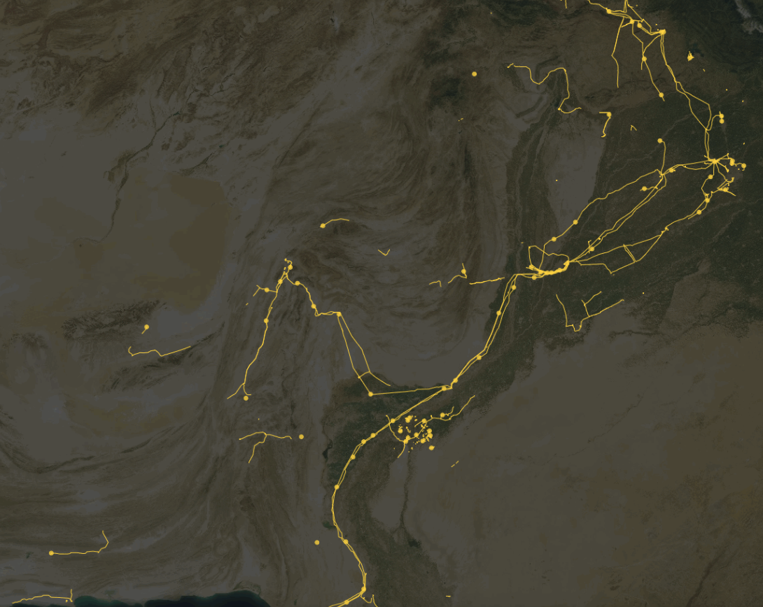
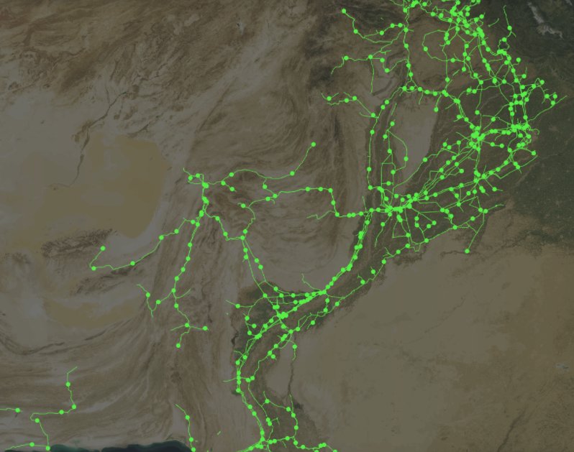

Recent Work
2017: Cooperation between World Bank and Development Seed
We are at proof-of-concept stage. Estimated compute and image cost for Africa: 34954.40$
Before
After
https://devseed.com/ml-grid-docs/results/mapping-output-and-speed/

Slide 8

PROBLEM
FORMULATOR
DATA
WORKFLOW
DATA
CREATION
SOLVER
UX
UI
@LINOPY
@SMS++
@PIPS-IPM++
@PYPSA
@PYPSA-AFRICA
@PYPSA-EUR
@PYPSA-EUR-SEC
@ATLITE
@PYPSA-AFRICA
@ALL
@?
@PYAM

Slide 9
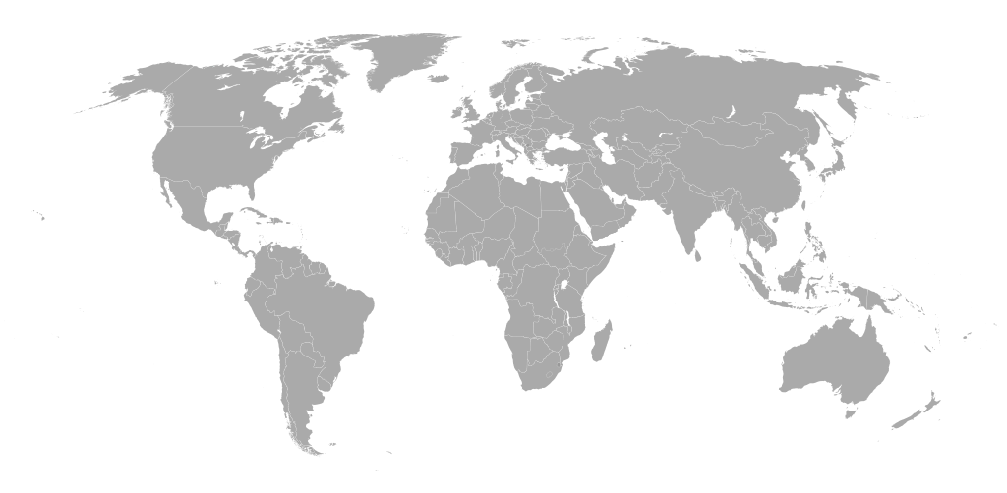
AGENDA
1. PyPSA-Earth Mission
2. Architecture on GitHub
3. Requirements of PyPSA-Africa
5. GitHub exercise
4. Installation routine and brief applied analysis
6. Workflow and debugging exercise
7. Dev-experience. Efficient vs. slow code. Teams, co-hacking and discord.
8. Final remarks

Slide 10
AGENDA
1. PyPSA-Earth Mission
2. Architecture on GitHub
3. Requirements of PyPSA-Africa
5. GitHub exercise
4. Installation routine and brief applied analysis
6. Workflow and debugging exercise
7. Dev-experience. Efficient vs. slow code. Teams, co-hacking and discord
8. Final remarks

Slide 11
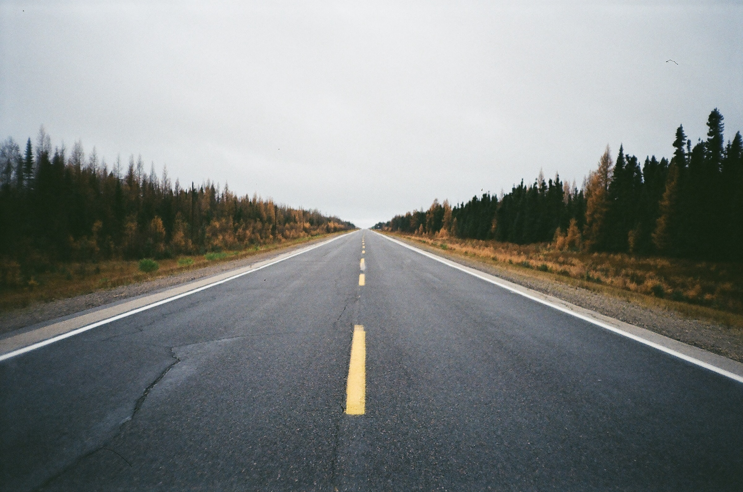
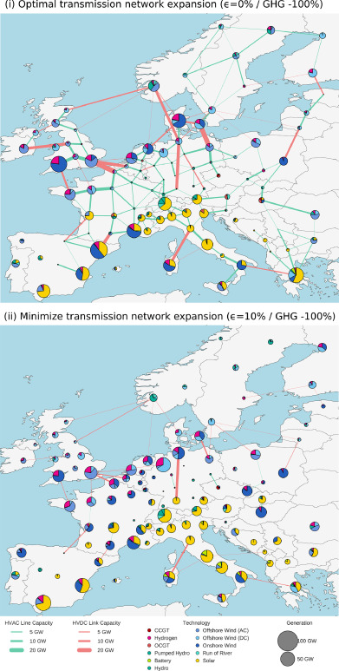
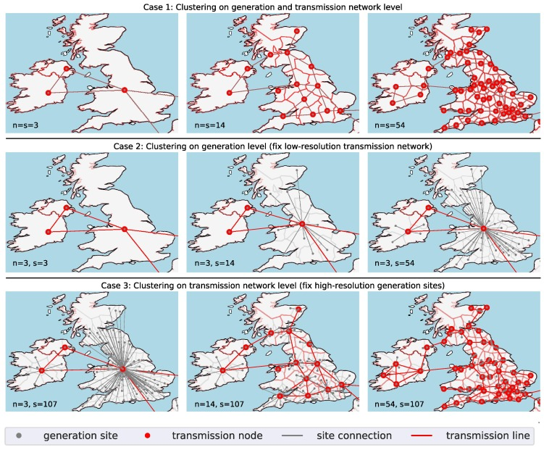
PERFORM SOME PLANNING STUDIES
INFLUENCE DECISION MAKING - CASA INDIA

Slide 12
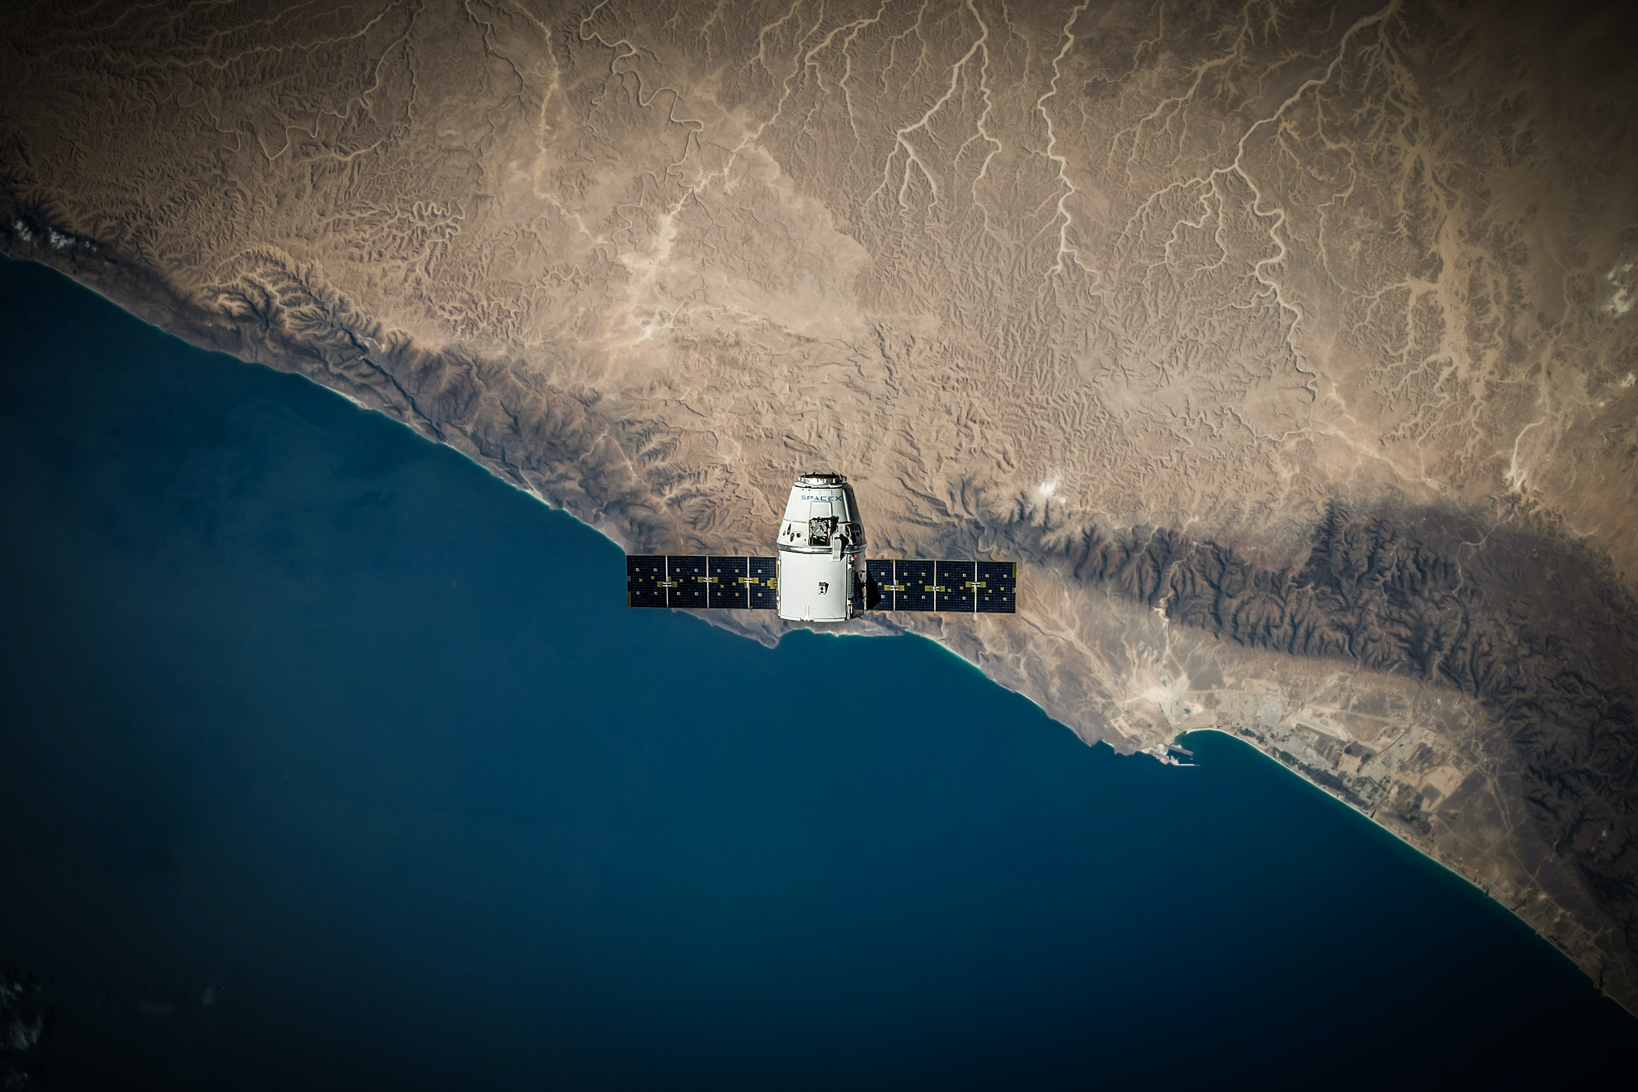
We can recognize everything from sky using satellites
*
*if the resolution is right

Slide 13
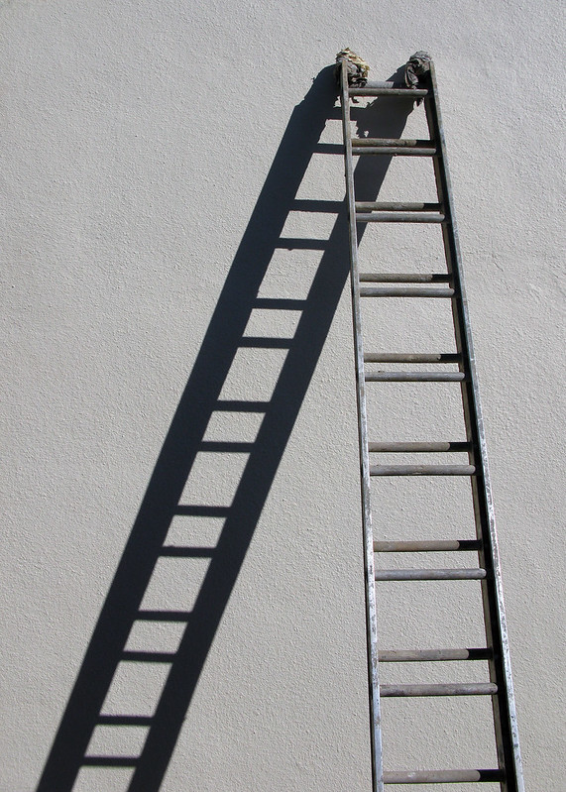
Open
Source
Ladder
LEAD
IMPROVE
PARTICIPATE
"up and down the ladder" by Robert Couse-Baker is licensed under CC BY 2.0
USE
UNDERSTAND

Slide 14
GETTING READY to CHANGe THE WORLD
HACKATHON 2021​ ​

